Slide 1
Dynamic Programming -
0-1 Knapsack Problem
Algorithms & Data Structures
ITCS 6114/8114
Dr. Dewan Tanvir Ahmed
Department of Computer Science
University of North Carolina at Charlotte

Slide 2
Dynamic Programming

Slide 3
Outline and Reading
0-1 Knapsack Problem (§5.3.3)

Slide 4

The 0/1 Knapsack Problem
Given: A set S of $n$ items, with each item $i$ having
$wi$ - a positive weight
$bi$ - a positive benefit
Goal: Choose items with maximum total benefit but with weight at most $W$.

Slide 5
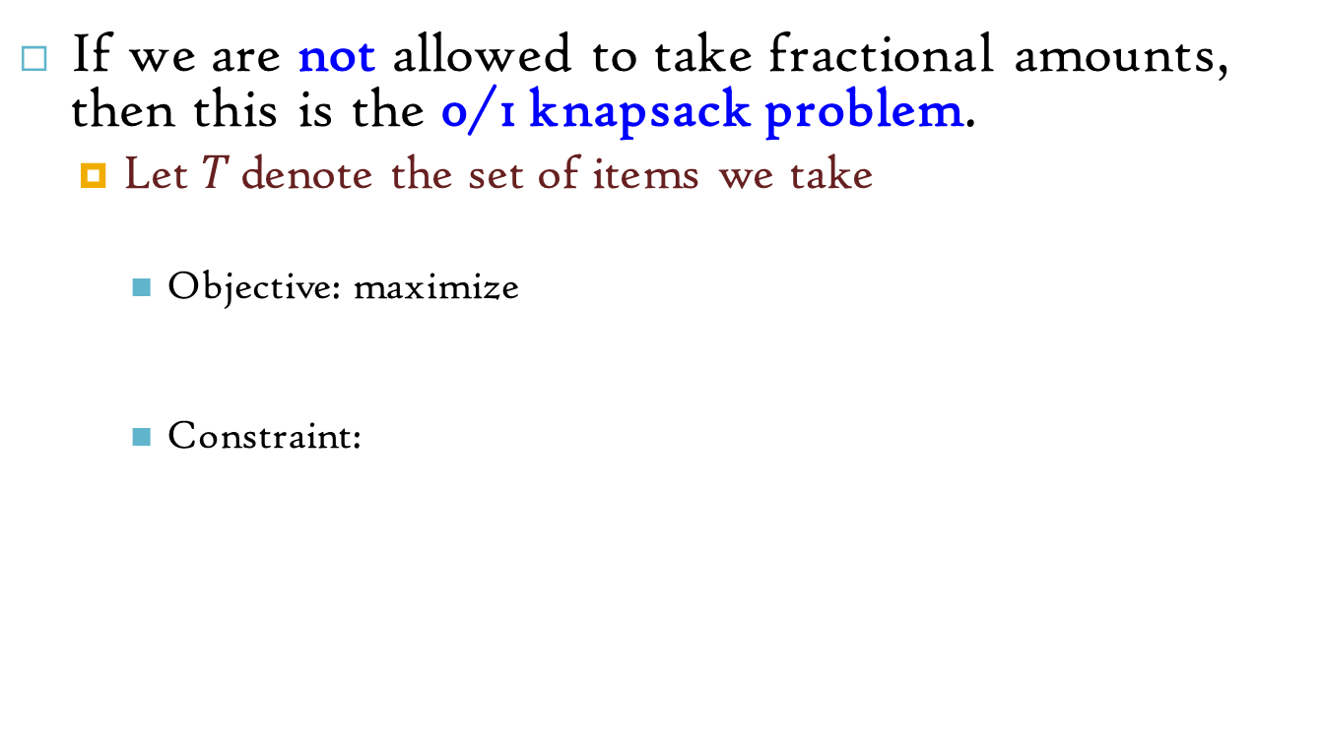
The 0/1 Knapsack Problem
If we are not allowed to take fractional amounts, then this is the 0/1 knapsack problem.
Let $T$ denote the set of items we take
Objective: maximize
Constraint:

Slide 6
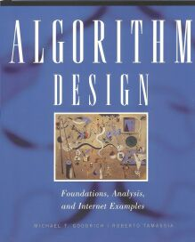
Example
“knapsack”
Items:
1
2
3
4
5
box of width 9 in
Weight:
Solution:
item 5 ($80, 2 in)
item 3 ($6, 2in)
item 1 ($20, 4in)
4 in
2 in
2 in
6 in
2 in
Benefit:
$20
$3
$6
$25
$80

Slide 7
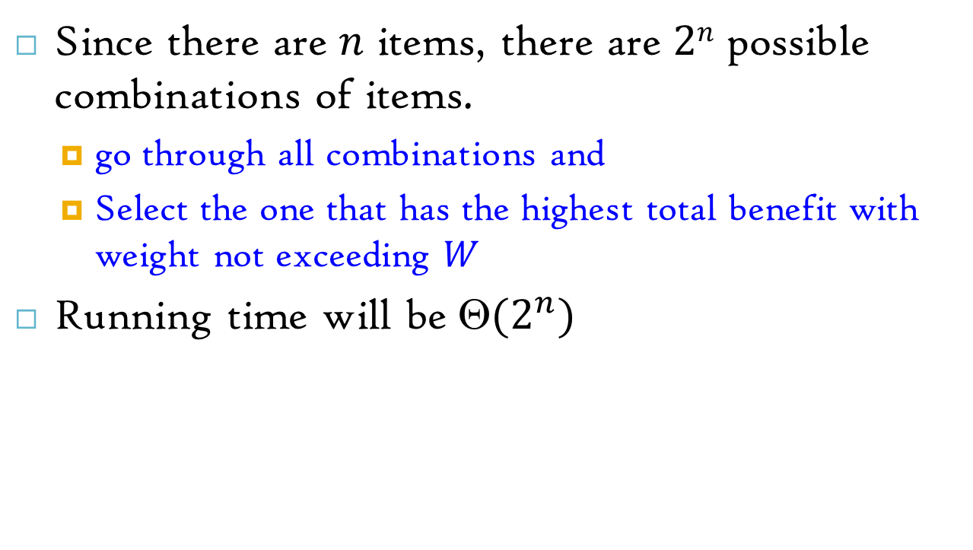
0-1 Knapsack problem: Brute-force approach
Since there are $n$ items, there are $2n$ possible combinations of items.
go through all combinations and
Select the one that has the highest total benefit with weight not exceeding $W$
Running time will be $(2^{n})$

Slide 8
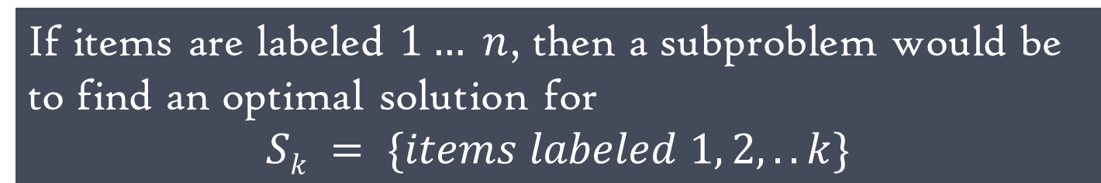
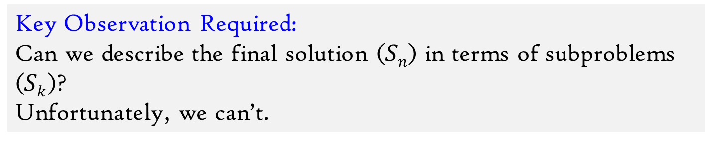
Defining a Subproblem
We need to carefully identify the subproblems
If items are labeled $1… n$, then a subproblem would be to find an optimal solution for
$$Sk = \{items labeled 1, 2, .. k\}$$
Key Observation Required:
Can we describe the final solution ($Sn$) in terms of subproblems ($Sk$)?
Unfortunately, we can’t.

Slide 9
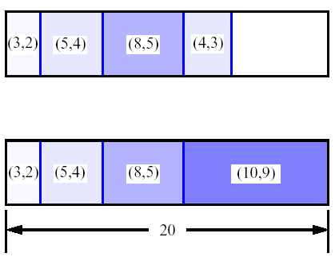
Defining a Subproblem
Weight
Benefit
Item
#
w_{i}
b_{i}
Best for S₄:
1
2
3
S₄
2
4
5
3
5
8
4
Best for S₅:
3
4
5
9
10
Solution for S4 is not part of the solution for S5.

Slide 10
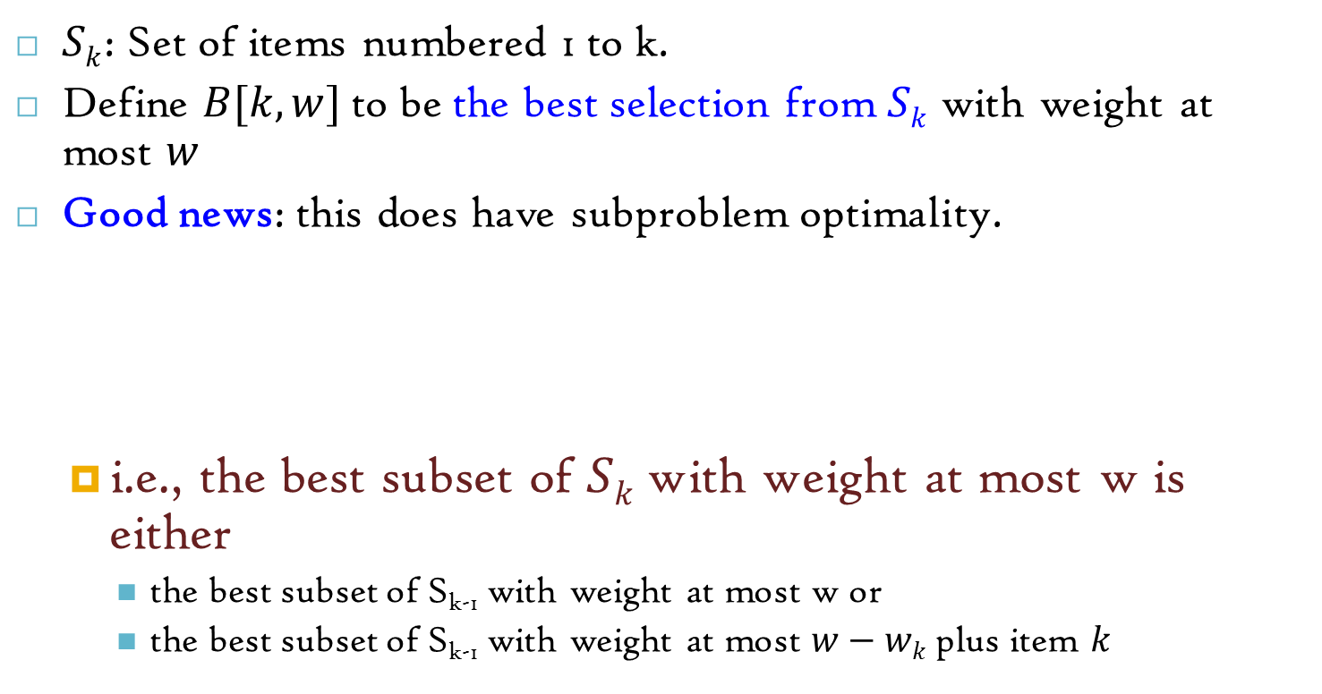
A 0/1 Knapsack Algorithm, Second Attempt
$Sk$: Set of items numbered 1 to k.
Define $B[k,w]$to be the best selection from $Sk$ with weight at most $w$
Good news: this does have subproblem optimality.
i.e., the best subset of $Sk$ with weight at most w is either
the best subset of S_{k-1} with weight at most w or
the best subset of S_{k-1} with weight at most $w−wk$ plus item $k$

Slide 11
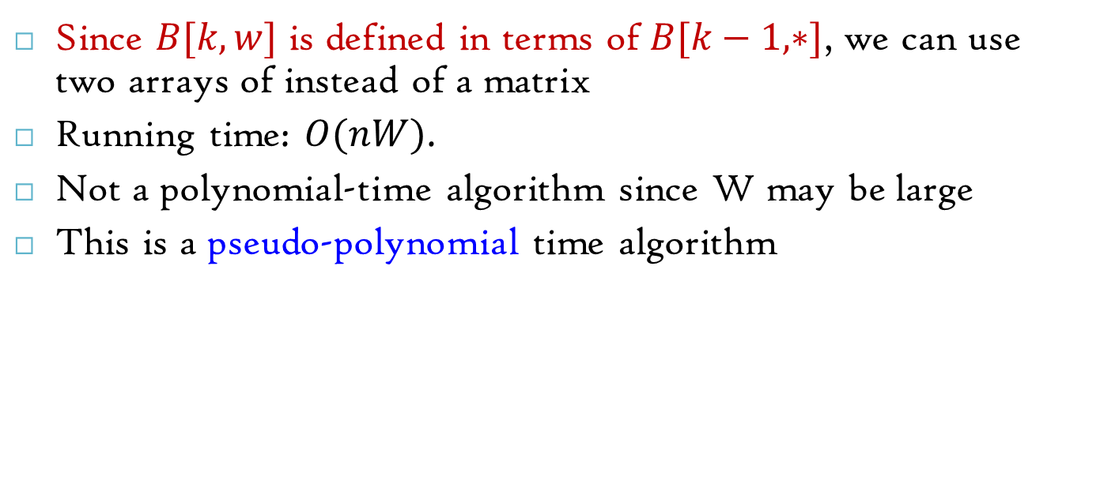
0/1 Knapsack Algorithm
Since $B[k,w]$ is defined in terms of $B[k−1,∗]$, we can use two arrays of instead of a matrix
Running time: $O(nW)$.
Not a polynomial-time algorithm since W may be large
This is a pseudo-polynomial time algorithm

Slide 12
0/1 Knapsack Algorithm
Algorithm 01Knapsack(S, W):
Input: set S of n items with benefit b_{i} and weight w_{i}; maximum weight W
Output: benefit of best subset of S with weight at most W
let A and B be arrays of length W + 1
for w ← 0 to W do
B[w] ← 0
for k ← 1 to n do
copy array B into array A
for w ← w_{k} to W do
if A[w-w_{k}] + b_{k} > A[w] then
B[w] ← A[w-w_{k}] + b_{k}
return B[W]

Slide 13
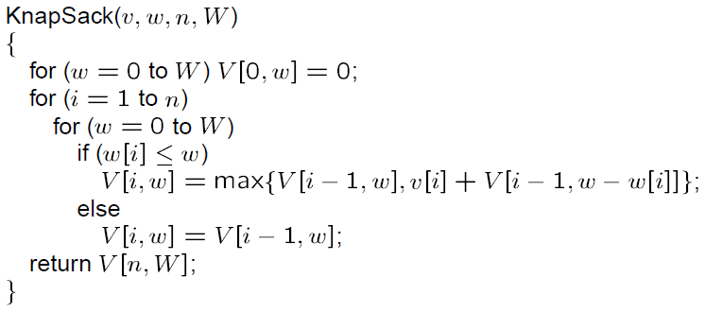
0/1 Knapsack Algorithm (using Matrix)

Slide 14
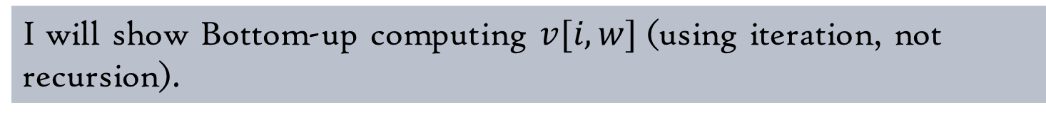
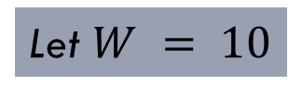
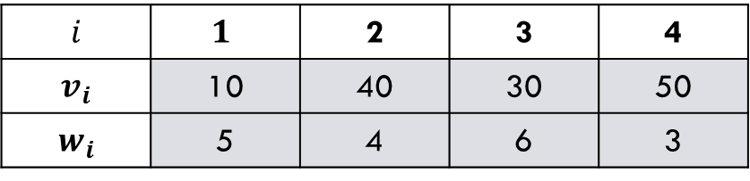
Example: 0/1 Knapsack Algorithm
Let $W = 10$
$$i$$ | $$1$$ | 2 | 3 | 4
$$v_{i}$$ | 10 | 40 | 30 | 50
$$w_{i}$$ | 5 | 4 | 6 | 3
I will show Bottom-up computing $v[i, w]$(using iteration, not recursion).

Slide 15
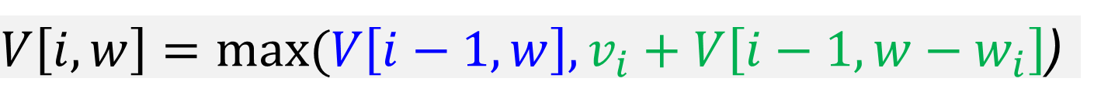
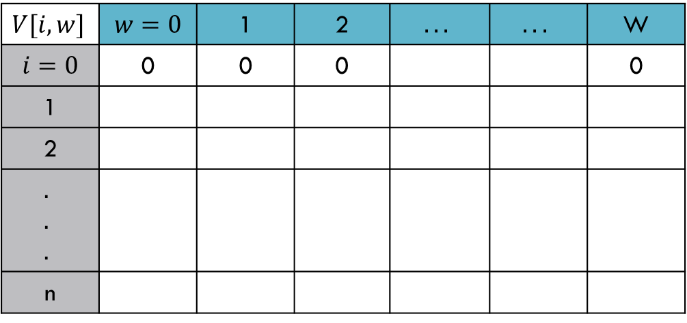
Example: 0/1 Knapsack Algorithm
Use the following equation and find the optimal value in bottom-up fashion.
$V\left[i,w\right]=max⁡(V\left[i−1,w\right],v_{i}+V\left[i−1,w−w_{i}\right]$)
$$V[i, w]$$ | $$w=0$$ | 1 | 2 | $$...$$ | $$...$$ | W
$$i=0$$ | 0 | 0 | 0 |  |  | 0
1
2
$$.$$ $$.$$ $$.$$
n

Slide 16
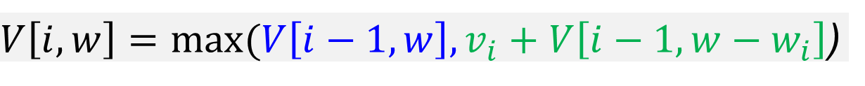
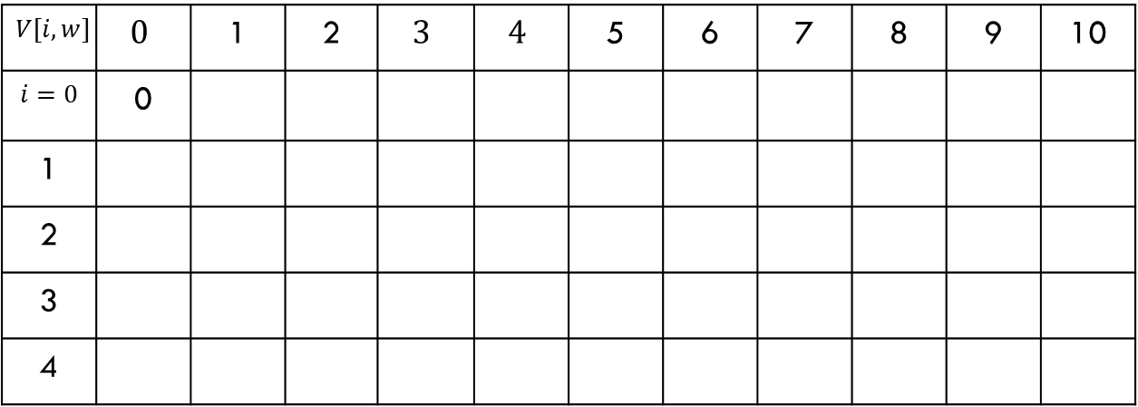

Example: 0/1 Knapsack Algorithm
$$i$$ | $$1$$ | 2 | 3 | 4
$$v_{i}$$ | 10 | 40 | 30 | 50
$$w_{i}$$ | 5 | 4 | 6 | 3
$V\left[i,w\right]=max⁡(V\left[i−1,w\right],v_{i}+V\left[i−1,w−w_{i}\right]$)
$$V[i, w]$$ | $$0$$ | 1 | 2 | $$3$$ | $$4$$ | 5 | 6 | 7 | 8 | 9 | 10
$$i=0$$ | 0
1
2
3
4
0 | 0 | 0 | 0 | 0 | 0 | 0 | 0 | 0 | 0
0
0
0
0
0 | 0 | 0 | 0
10 | 10 | 10 | 10 | 10 | 10
0 | 0 | 0 | 40
40 | 40 | 40 | 40

Slide 17
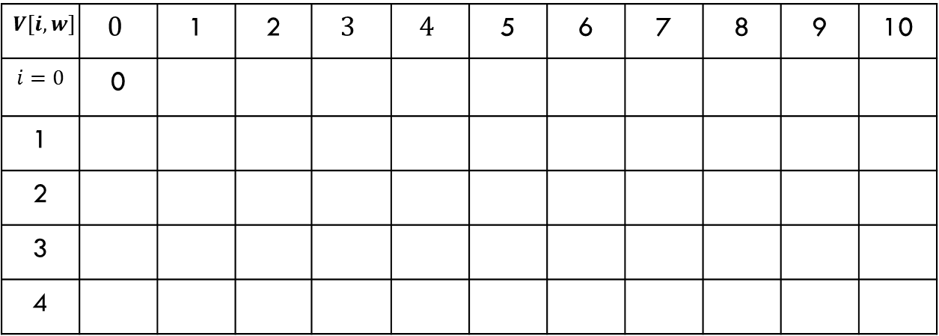
Example: 0/1 Knapsack Algorithm
$$i$$ | $$1$$ | 2 | 3 | 4
$$v_{i}$$ | 10 | 40 | 30 | 50
$$w_{i}$$ | 5 | 4 | 6 | 3
$V\left[i,w\right]=max⁡(V\left[i−1,w\right],v_{i}+V\left[i−1,w−w_{i}\right]$)
10 | (40+10)
$$V[i, w]$$ | $$0$$ | 1 | 2 | $$3$$ | $$4$$ | 5 | 6 | 7 | 8 | 9 | 10
$$i=0$$ | 0
1
2
3
4
0 | 0 | 0 | 0 | 0 | 0 | 0 | 0 | 0 | 0
0
0
0
0
0 | 0 | 0 | 0
10 | 10 | 10 | 10 | 10 | 10
0 | 0 | 0 | 40
40 | 40 | 40 | 40
50 | 50

Slide 18
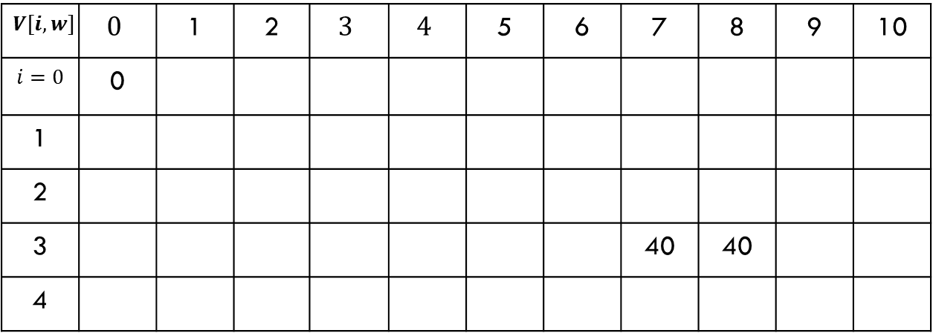
Example: 0/1 Knapsack Algorithm
$$i$$ | $$1$$ | 2 | 3 | 4
$$v_{i}$$ | 10 | 40 | 30 | 50
$$w_{i}$$ | 5 | 4 | 6 | 3
$V\left[i,w\right]=max⁡(V\left[i−1,w\right],v_{i}+V\left[i−1,w−w_{i}\right]$)
50 | (30+0)
$$V[i, w]$$ | $$0$$ | 1 | 2 | $$3$$ | $$4$$ | 5 | 6 | 7 | 8 | 9 | 10
$$i=0$$ | 0
1
2
3 |  |  |  |  |  |  |  | 40 | 40
4
0 | 0 | 0 | 0 | 0 | 0 | 0 | 0 | 0 | 0
0
0
0
0
0 | 0 | 0 | 0
10 | 10 | 10 | 10 | 10 | 10
0 | 0 | 0 | 40
40 | 40 | 40 | 40
50 | 50
0 | 0 | 0 | 40 | 40 | 40
50

Slide 19
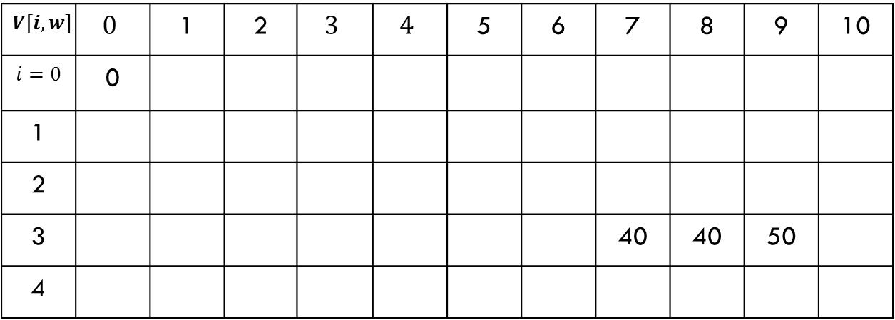
Example: 0/1 Knapsack Algorithm
$$i$$ | $$1$$ | 2 | 3 | 4
$$v_{i}$$ | 10 | 40 | 30 | 50
$$w_{i}$$ | 5 | 4 | 6 | 3
$V\left[i,w\right]=max⁡(V\left[i−1,w\right],v_{i}+V\left[i−1,w−w_{i}\right]$)
50 | (30+40)
$$V[i, w]$$ | $$0$$ | 1 | 2 | $$3$$ | $$4$$ | 5 | 6 | 7 | 8 | 9 | 10
$$i=0$$ | 0
1
2
3 |  |  |  |  |  |  |  | 40 | 40 | 50
4
0 | 0 | 0 | 0 | 0 | 0 | 0 | 0 | 0 | 0
0
0
0
0
0 | 0 | 0 | 0
10 | 10 | 10 | 10 | 10 | 10
0 | 0 | 0 | 40
40 | 40 | 40 | 40
50 | 50
0 | 0 | 0 | 40 | 40 | 40
70

Slide 20
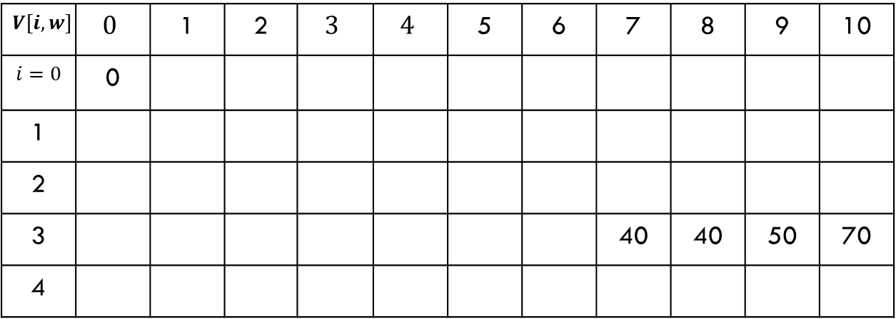

Example: 0/1 Knapsack Algorithm
$$i$$ | $$1$$ | 2 | 3 | 4
$$v_{i}$$ | 10 | 40 | 30 | 50
$$w_{i}$$ | 5 | 4 | 6 | 3
$V\left[i,w\right]=max⁡(V\left[i−1,w\right],v_{i}+V\left[i−1,w−w_{i}\right]$)
40 | (50+40)
$$V\left[4,10\right]=90$$
$$V[i, w]$$ | $$0$$ | 1 | 2 | $$3$$ | $$4$$ | 5 | 6 | 7 | 8 | 9 | 10
$$i=0$$ | 0
1
2
3 |  |  |  |  |  |  |  | 40 | 40 | 50 | 70
4
0 | 0 | 0 | 0 | 0 | 0 | 0 | 0 | 0 | 0
0
0
0
0
0 | 0 | 0 | 0
10 | 10 | 10 | 10 | 10 | 10
0 | 0 | 0 | 40
40 | 40 | 40 | 40
50 | 50
0 | 0 | 0 | 40 | 40 | 40
0 | 0 | 50
50 | 50 | 50
90 | 90 | 90 | 90

Slide 21

Find the actual subset
To compute the actual subset
add an auxiliary array $taken[i,w]$
which is 1 if we decide to take the $i−th$ item in $V[i,w]$and 0 otherwise.

Slide 22
Reference
Algorithm Design: Foundations, Analysis, and Internet Examples. Michael T. Goodrich and Roberto Tamassia. John Wiley & Sons.
Introduction to Algorithms. Thomas H. Cormen, Charles E. Leiserson, Ronald L. Rivest, Clifford Stein.

Slide 23
Thank you!

